Slide 1
NYC Tips and Taxis
Group 0: Roy, Forrest, Shanakay, Jeff

Slide 2
Business Questions
Do certain socioeconomic factors (crime, high-end restaurants, wealth) impact tip amounts?

Slide 3
Table of Contents
Data
Size
Process
Cleaning
Findings
Uber vs NYC Taxi
Crime Rate
High End Restaurants
Conclusion
Road Blocks
Future Steps

Slide 4
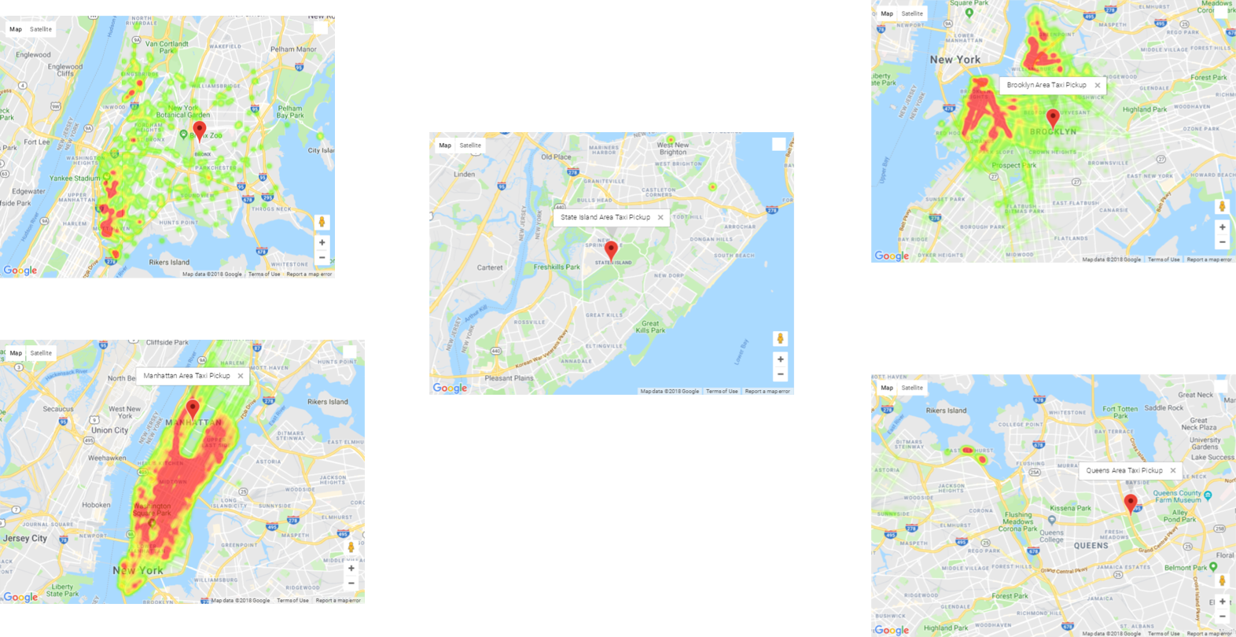
Introduction of NYC Taxi Dataset

Slide 5
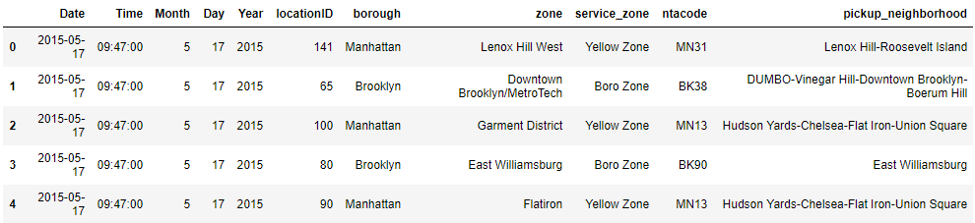
Uber Dataset Info
14,264,215 Data Points / 1.5 GB
Split into Date, Time
Added neighborhood tabulation areas (NTA)

Slide 6
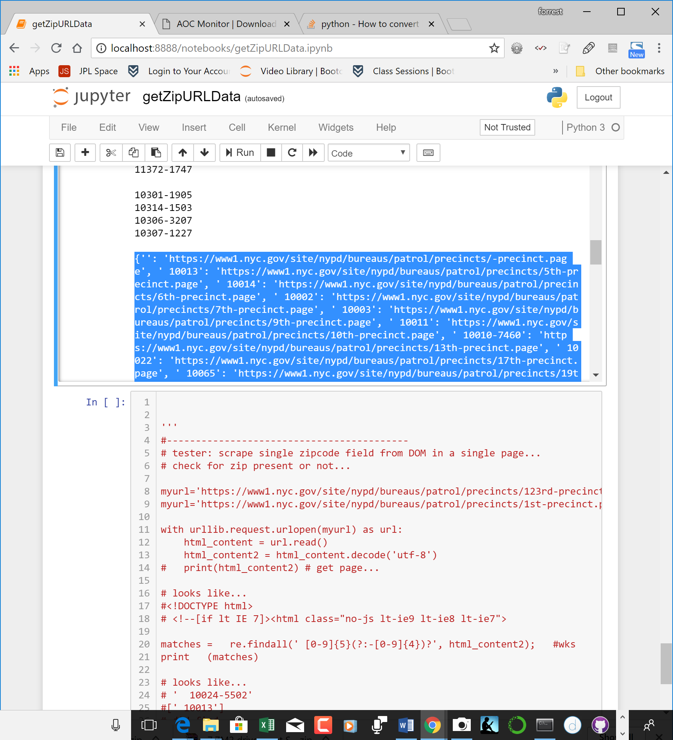
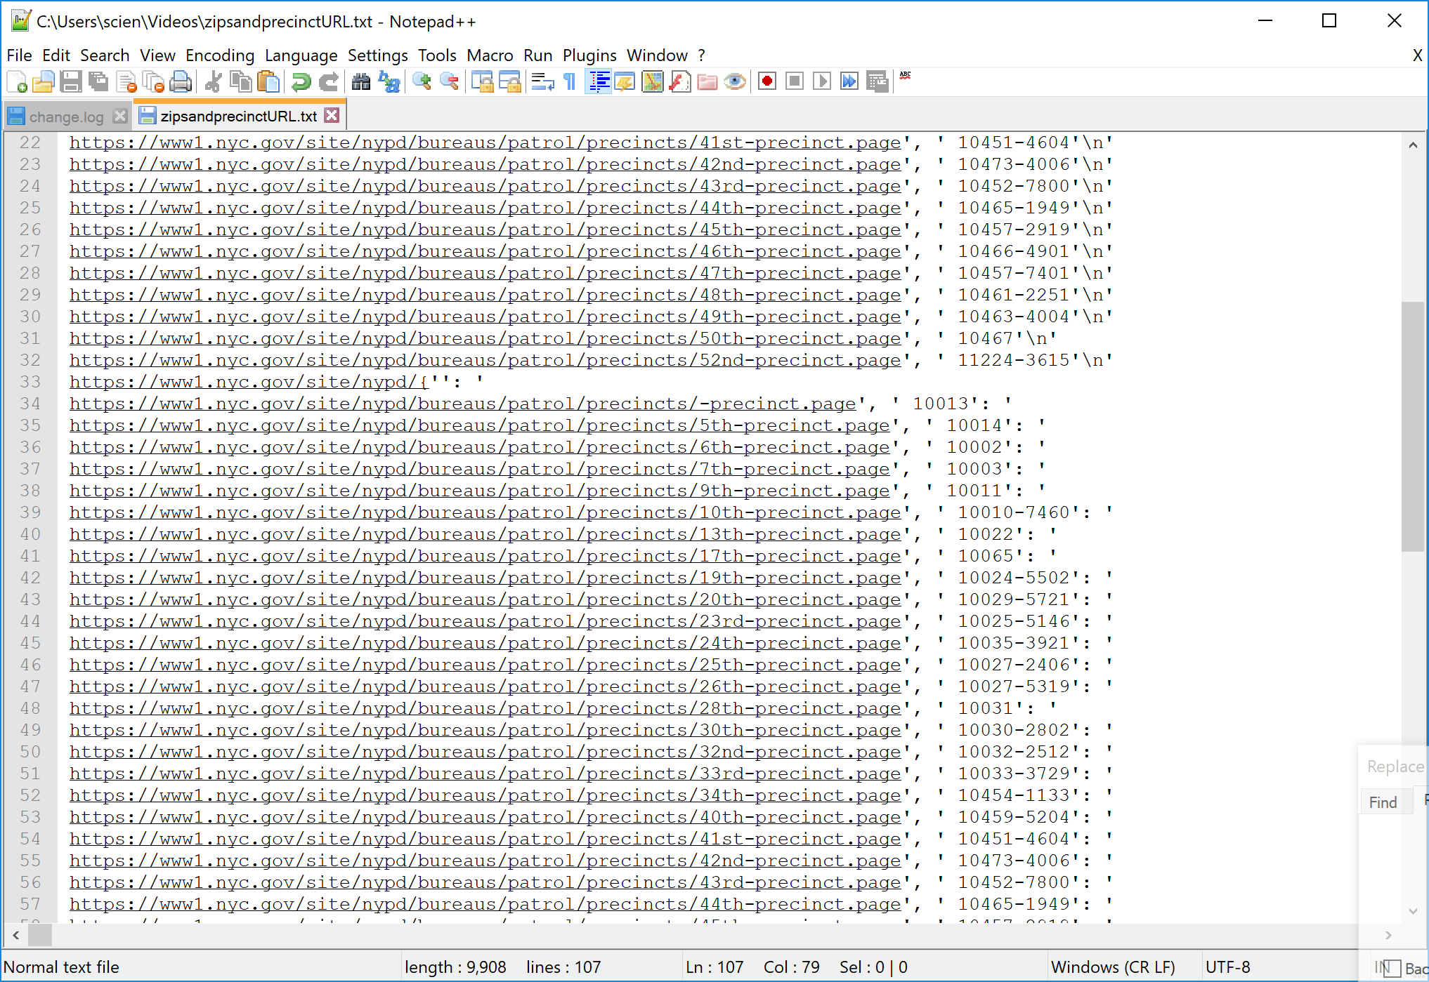
Crime Dataset Info

Slide 7
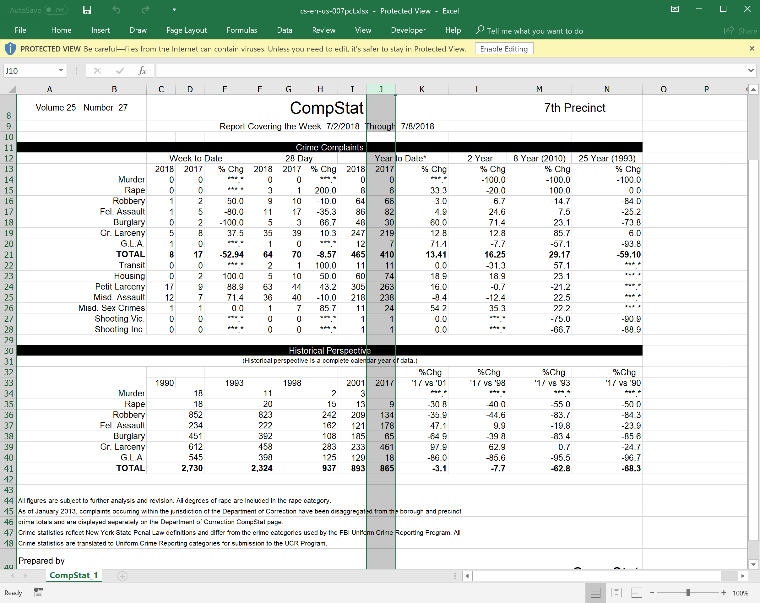
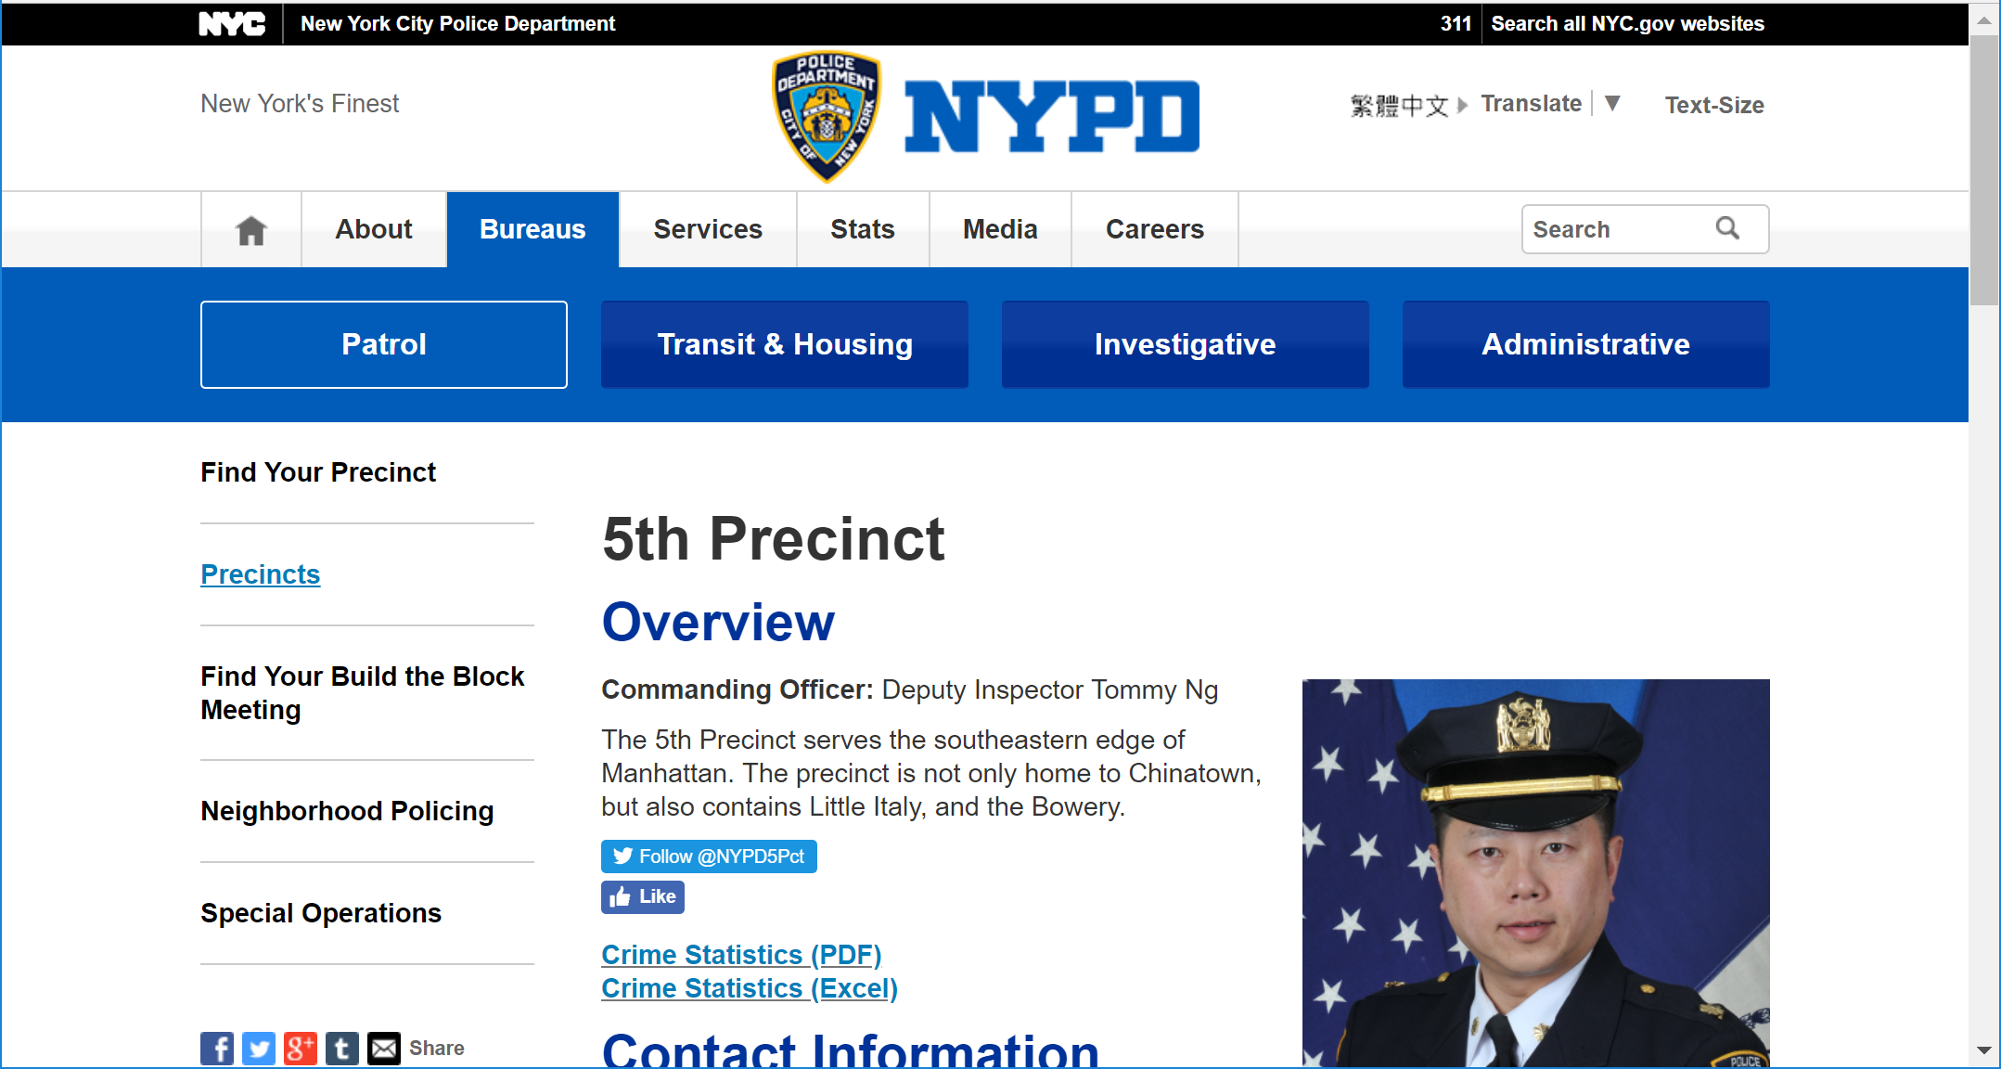
Crime Dataset Info Cont.

Slide 8
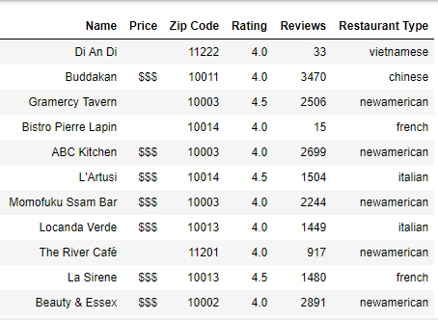
Yelp Restaurant Dataset
Yelp Business Search API
140 Total NYC Restaurants
Rated 4-5 Stars
$$$ or $$$$ cost
Review Count >10

Slide 9
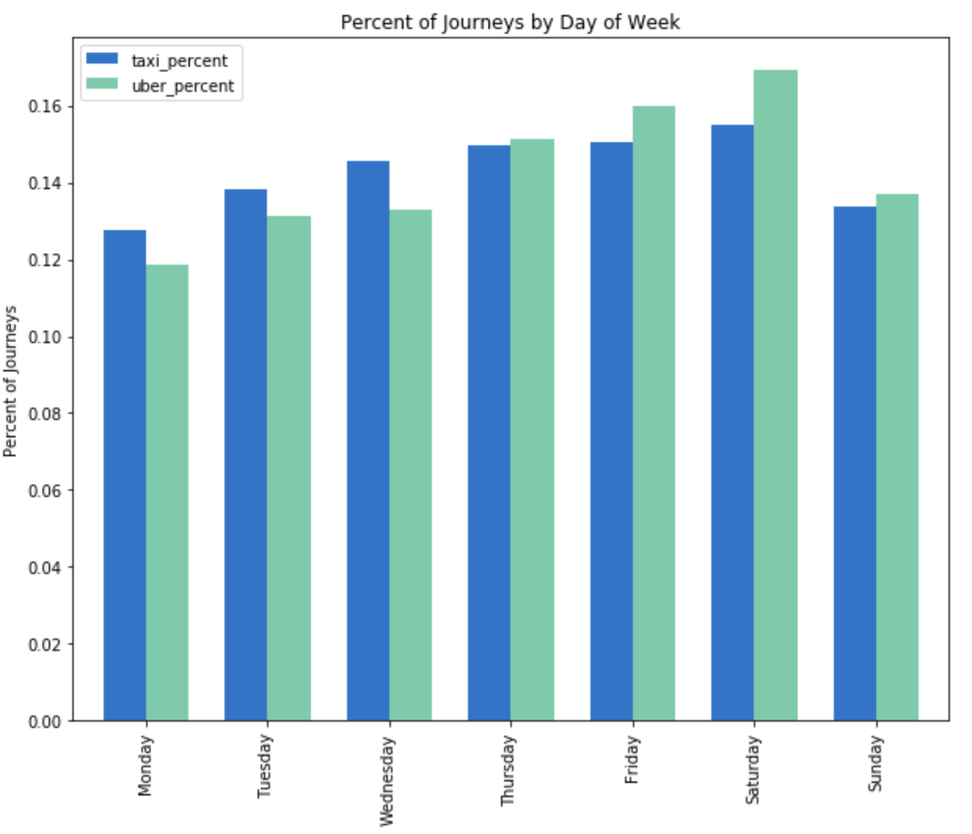
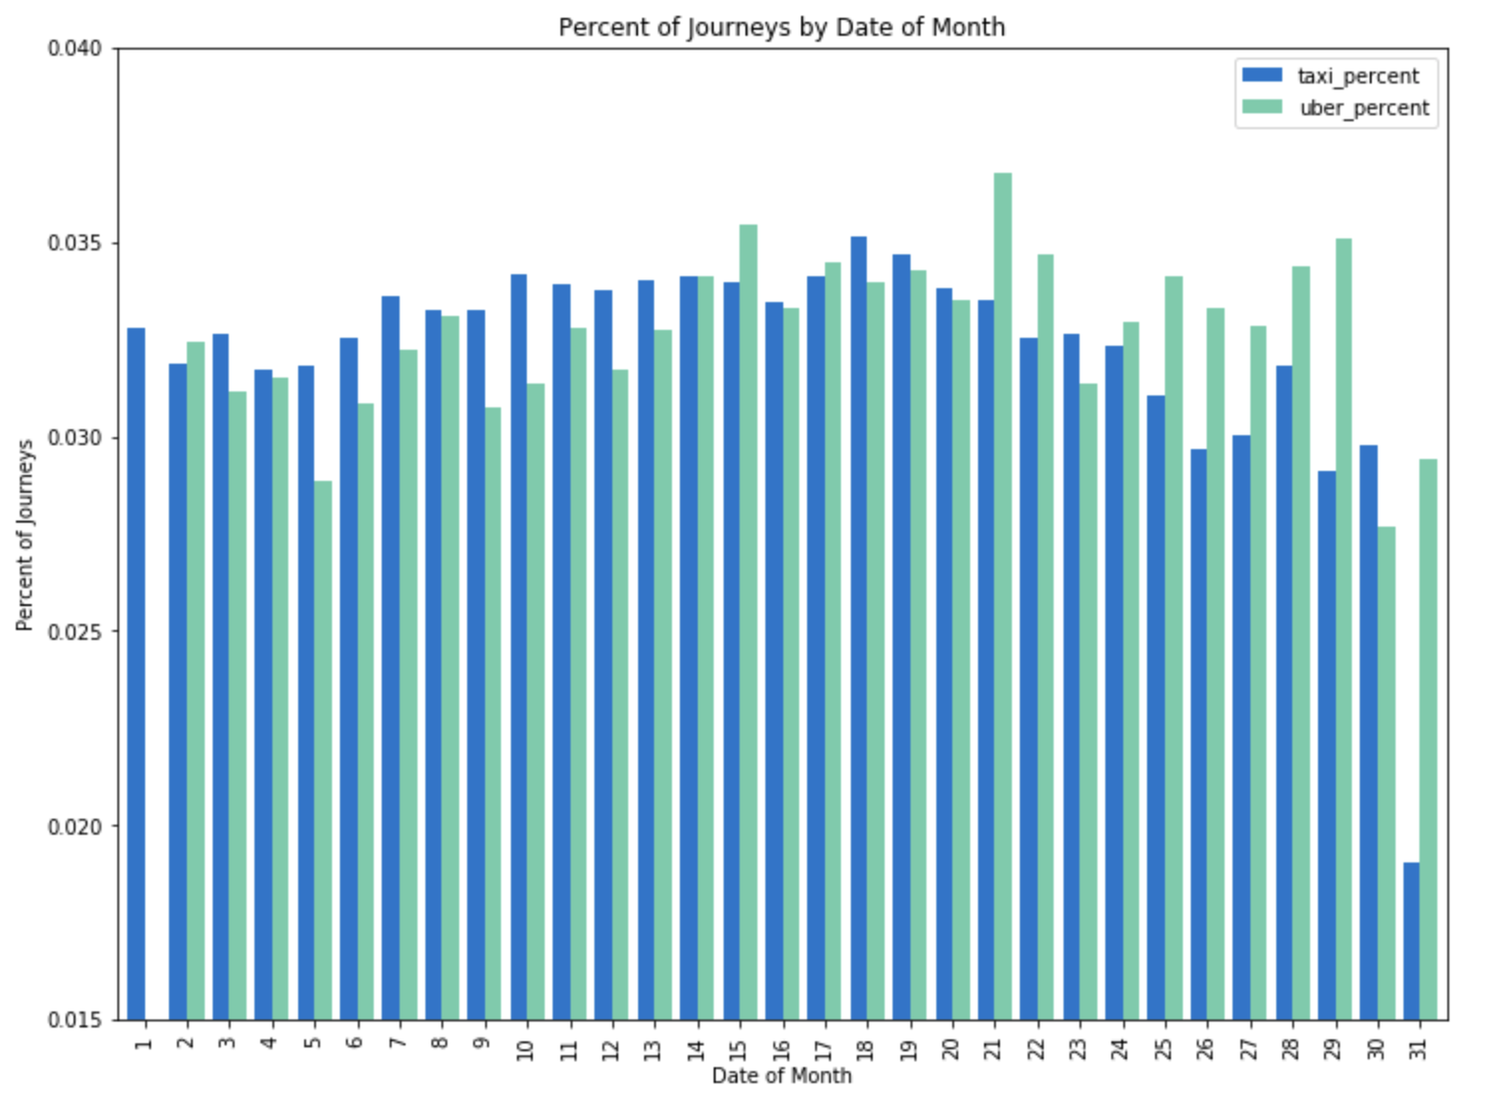
Comparison of NYC Taxi and Uber

Slide 10
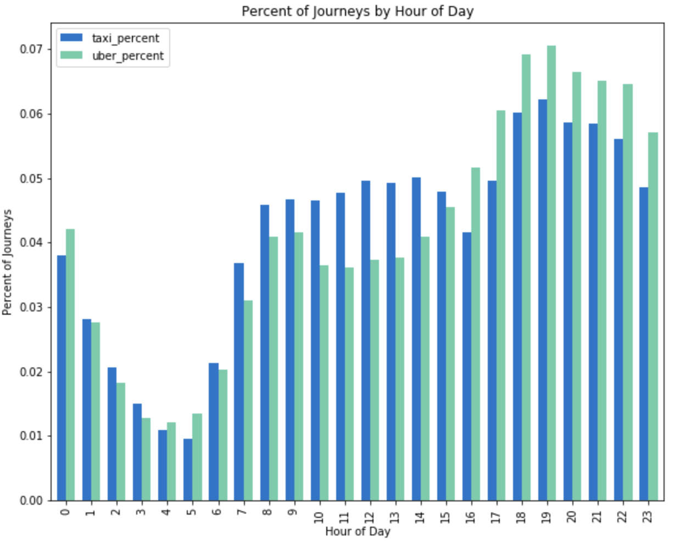
Percent of Journey by Hour of Day

Slide 11
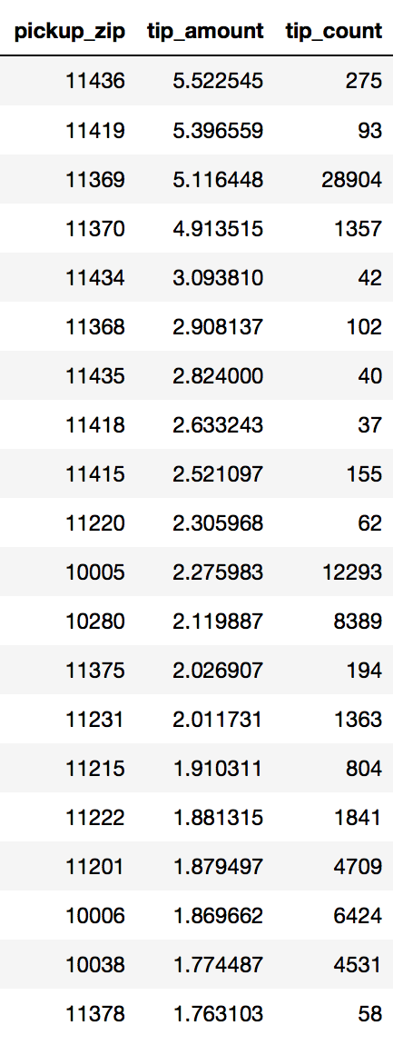
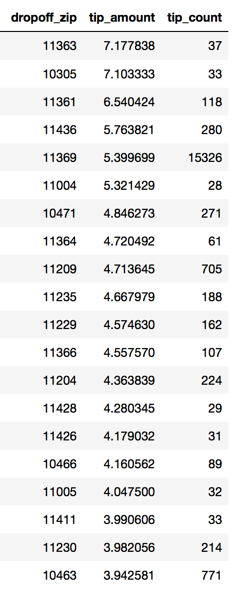
Correlations between Wealth & Tipping behaviors
Obtain top 20 zip codes by average tip amount
Pick-up & Drop-off
Compare with top 10 wealthiest zip codes
Pick-up: 1 match Drop-off: 2 match

Slide 12
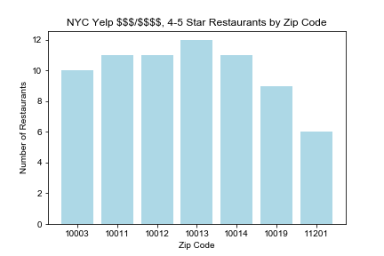
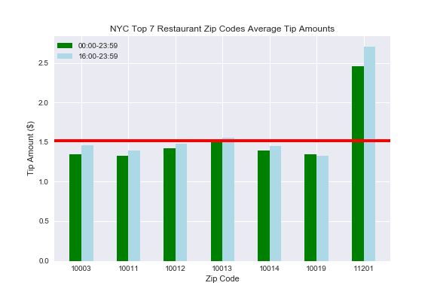
NYC Expensive Restaurants and Tip Correlation
sing Jan-
11201 -Brooklyn, NY
Using Jan-Jun 2015 Nyc Taxi data
Average NYC Tip Amount: $1.52

Slide 13
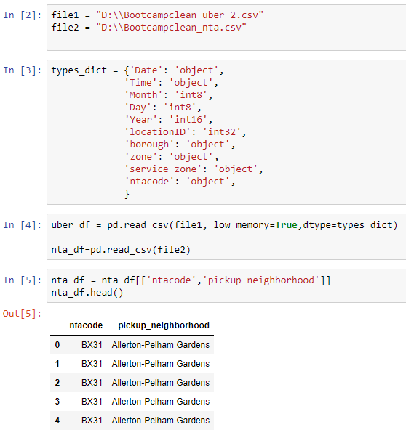
Data Roadblocks
With 14 million lines in the uber dataset, simple lines of code ie. merging datasets became memory intensive
With the file being 1.5 GB, storing on Github wasn’t possible even with LFS
Solutions: Gitlab

Slide 14
Conclusions
Wealth: weak correlation between wealthy neighborhoods and tip amounts
Crime: no convincing correlation between crime rates and tip amounts
High-end Restaurants: weak correlation between dinner hours and non-dinner hours
Based on our analysis thus far, there is no significant correlation between tipping and the 3 socio economic factors chosen

Slide 15
Future Steps
Look into other socio economic factors: ethnicity, age, education
Wealth: Residential Area vs Business Area
Yelp: Dive deeper into other business types within Yelp API
Crime: Discover better datasets to help answer what kind of impacts crime data has on tipping behavior

Slide 16
Future Business Question: Weather
Does New York weather have an impact on people’s behavior to take taxis?

Slide 17
Questions or Comments?

